Slide 1
Lecture 23: Natural Acceptance of Human Values
(Implications of the Right Understanding)

Slide 2


Slide 3
UHV-II: A Foundation Course in Universal Human Values and Ethics (aka. Understanding Harmony)
LTPC 3-1-0-3 Mandatory Credit Course in 3rd/4th Semester 28 lectures and 14 tutorials
Module 5 – Implications of the Holistic Understanding – a Look at Professional Ethics (6 lectures and 3 tutorials for practice sessions)
Lecture 23: Natural Acceptance of Human Values
Lecture 24: Definitiveness of (Ethical) Human Conduct
Tutorial 12: Practice Session PS12 Exploring Ethical Human Conduct
Lecture 25: A Basis for Humanistic Education, Humanistic Constitution and Universal Human Order
Lecture 26: Competence in Professional Ethics
Tutorial 13: Practice Session PS13 Exploring Humanistic Models in Education
Lecture 27: Holistic Technologies, Production Systems and Management Models-Typical Case Studies
Lecture 28: Strategies for Transition towards Value-based Life and Profession
Tutorial 14: Practice Session PS14 Exploring Steps of Transition towards Universal Human Order

Slide 4
Placement of Module 5
Understanding Harmony
Modules 1-4
Feeling of relationship
mutual fulfilment, values
Thought Principles and
Guidelines for
Ethical Human Conduct
Module 5
Behaviour Ethical behaviour
Work and Ethical work (examples and
Participation Ethical participation case studies…)
Outcome Continuous happiness at individual level and
expected Fulfilment of human goal at societal level

Slide 5
Basis for Universal Human Values
Recap
In previous lectures, we concluded by identifying co-existence in the entire existence.
In the following lectures, we will try to understand how right understanding provides the basis for universal human values enabling their natural assimilation.

Slide 6
Natural Acceptance of Human Values
Based on our understanding of harmony, we participate in the larger order.
Our participation at different levels is our value.
The identification of values is based on realisation and understanding. The participation of the human being is in the form of behaviour and work.
We studied about the values of behaviour as the nine values in relationship: trust, respect, affection, care, guidance, reverence, gratitude, glory and love.
Likewise, working with material things, ensuring their right utilisation, enrichment and protection is our value.
It results into prosperity for human being and preservation (enrichment, protection and right utilisation) of the rest of nature

Slide 7
Consolidated List of Human Values
In the Self – Continuous happiness- Happiness, Peace, Satisfaction, Bliss
In Human Being- with Body- Feeling of self-regulation in self, health in body
In Human-Human Relationship – Justice
(established values- trust,… love + expressed values- … compassion)
4. In Human-Rest of Nature Relationship – Prosperity in human being, preservation (enrichment, protection and right utilisation) of rest of Nature
5. In Universal Human Order – participation in different systems -Perseverence, Bravity, Generosity, Kindness, Beneficience, Compassion –
The value of a human being is something definite
In that sense, human values are definite
The participation of a human being living with human consciousness is definite – in the Self, in human-human relationship, in human-rest of nature relationship and in the human society (universal human order)
NOTE: That definite participation can be described in multiple ways
This is one description of that definite participation (human values)

Slide 8
Universal Values Naturally Emerging from the Right Understanding
From earlier discussions, we can easily infer that there is an innate harmony and orderliness in the existence.
The human beings only need to understand it (and not to create it).
The universal human values are manifestations of the truth of existence, i.e. co-existence, in various dimensions of human participation in the existential order.
These values are naturally acceptable to all human beings and conducive to human happiness (an wellbeing of all).
Only our ignorance leads to all the difficulties and confusions in appreciating and inculcating these universal values.

Slide 9
Development of Human Consciousness
As explained earlier, the journey towards right understanding in fact brings a transformation in the human being from ‘animal consciousness’ to ‘human consciousness’.
In ‘animal consciousness’, we give first priority to physical facility.
But as we transform to the human consciousness, we are able to base our thoughts and activities on right understanding, give relationship a higher priority than physical facility, identify our physical needs and ensure it through cyclic and mutually enriching production processes, thereby enriching rest of the nature as well.

Slide 10
Implications of Value-based Living
At the level of individual:
  Transition towards happiness and prosperity, slowly getting rid of the contradictions and conflicts within through self-exploration and thus getting rid of the tension, frustration, depression, one-upmanship, psycho-somatic disorders etc. facilitating definite human conduct.
  The feeling of self-regulation will reduce the occurrence of diseases and in turn the feeling of insecurity. This will help the individual lead a more fulfilling life.
At the level of family:
  Value-based living facilitating peace and harmony in the family, with more occurrences of just and fulfilling behaviour raising the feeling of togetherness in the families and reducing the family feuds.
  People will feel prosperous and the feeling to nurture others will grow in the families.
  Such harmonious living will also help reduce the consumerist behaviour in family celebrations like marriages, parties and other social functions.

Slide 11
Implications of Value-based Living…
At the level of society:
  Mutual trust and fearlessness developing in the society, reduction of discrimination on the basis of body (in terms of gender, age or race), physical facility (in terms of wealth or posts) and beliefs (in terms of isms, sects, etc), solution emerging to problems like terrorism, communalism and international conflicts etc.
  The feeling of undividedness will grow in the society.
  Fulfilment of human goal will start getting to the fore in our plans and projects at all levels and gradually a human order based on trustful relationships will slowly emerge.
At the level of nature:
  Human order fulfilling all the other three orders of nature, problems of pollution and resource depletion being handled smoothly when people are able to judge appropriately their needs for physical facility themselves and the mode of fulfilment is eco-friendly.
  Better methods of farming and production will help cut down problems of greenhouse gases, ozone depletion, ecological imbalance, etc.
  The various species of animals and birds can be saved from extinction and forests can be replenished.

Slide 12
Key Takeaways
Values are naturally acceptable and value-based living is a natural outcome of the right understanding.
Its implications can be seen at all levels of living of human being.

Slide 13
FAQs for Lecture 23
Natural Acceptance of Human Values

Slide 14
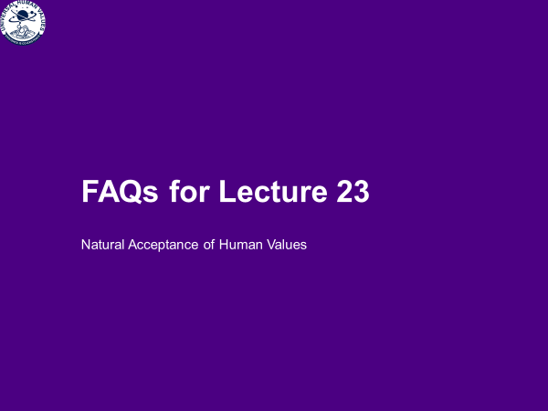

Slide 15
FAQ

Slide 16
Why ethics when righ understanding is already ensured?
Details helpful for review of conduct, for sharing…
For Children, who are in the stage of following, discipline
Ethics
How we express, how we fulfil..
Not only about restrictions

Slide 17
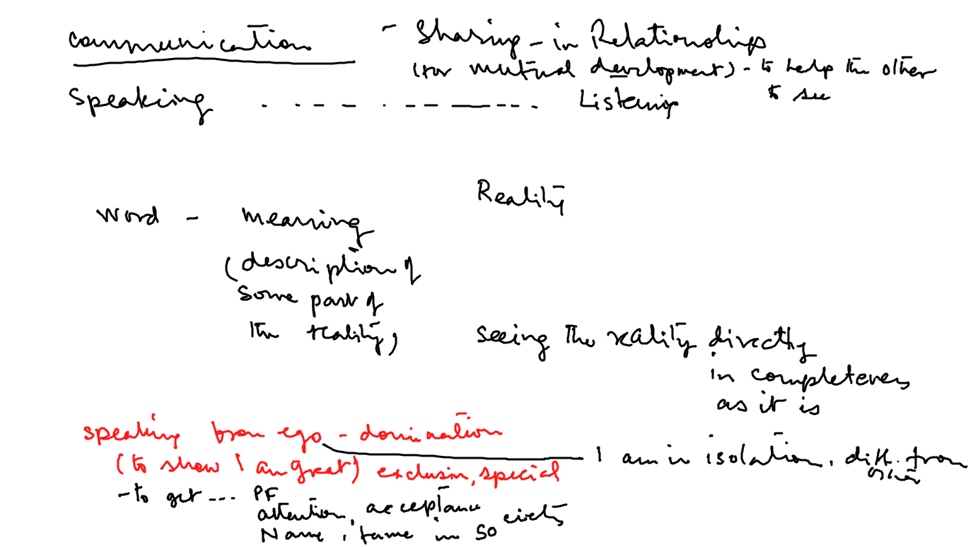
(Ethical) Human Communication and Inhuman Communication

